Slide 1

GUJARAT INDUSTRIAL HACKATHON 2018-19

Slide 2

Team ID:-TG001068 Team Name:-Hack O’ Holicss Problem Statement ID :- GIH102 Problem Statement:- IOT Based Accident Prone Device
A.D. PATEL INSTITUTE OF TECHNOLOGY

Slide 3
IOT BASED ACCIDENT PRONE DEVICE
According to the survey in 2017, approximately the total of 2,076 people died in road accidents. Due to the lack of emergency facilities in our country, we are introducing the automatic alert device for vehicle accidents. The proposed system detects the accident and sends the information in less time to emergency services like 108.

Slide 4
PROBLEMS OCCURS DURING ACCIDENT
If the accident occurs in the rural areas then sometimes the assistance to the victim is not provided at time.
The person is travelling on bicycle or bike in remote areas and meets with an accident are not taken to hospital on time.
PROBLEMS
Location of accident is not known to the emergency services like 108 on time.
If accident occurs then person's family can't get information of it.And also hospitals can’t know the identity of the person without person's family contact.

Slide 5
PROCESS FLOW
ACCIDENT DETECTED THROUGH MPU 6050 (GYROSCOPE AND ACCELEROMETER)
THEN GSM MODULE SEND THE MESSAGE TO
EMERGANCY SERVICES
ARDUINO WILL TRIGGER THE SIM 808
1
2
3
4
5
RECEIVED SIGNAL FROM MPU 6050 BY ARDUINO UNO
SIM 808 WILL FETCH THE LIVE LOCATION VIA GPS MODULE

Slide 6
PROCESS DESCRIPTION
First and fore most thing that we are going to do is to interface MPU6050 SENSOR which includes Gyroscope and accelerometer. Gyroscope calculates the angular velocity and accelerometer calculates the linear acceleration. By combining both the readings, we examine the threshold value which detects the accident and MPU6050 sends the signal to Arduino. Then Arduino triggers the SIM808 module. SIM808 comprises of GPS and GSM module. The GPS tracks longitude and latitude which helps to get LIVE LOCATION with google map link and GSM sends the message to CENTRAL CONTROL ROOM like emergency services 108. Thus the delay can be avoided and victim can be taken to hospital as soon as possible.

Slide 7
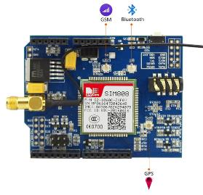
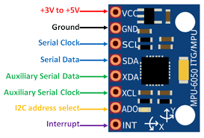
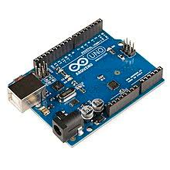
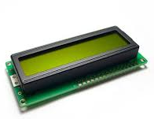
HARDWARE COMPONENTS
SIM 808
MPU 6050
ARDUINO UNO
LCD

Slide 8
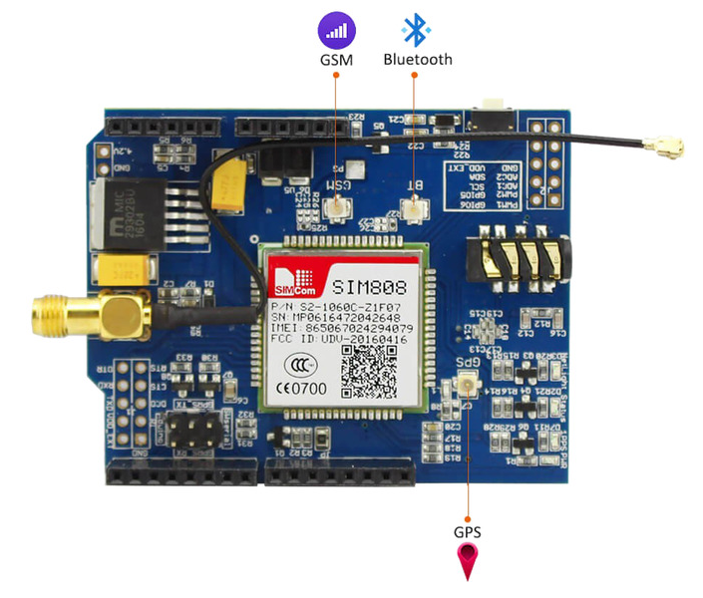
SIM 808
SIM808 module is a GSM and GPS two-in-one function module. It is based on the latest GSM/GPS module SIM808 from SIMCOM, supports GSM/GPRS Quad-Band network and combines GPS technology for satellite navigation. The latest firmware support bluetooth function.

Slide 9
MPU 6050
The MPU 6050 is a 6 DOF (degrees of freedom) or a six-axis IMU sensor, which means that it gives six values as output: three values from the accelerometer and three from the gyroscope. The MPU 6050 is a sensor based on MEMS (micro electro mechanical systems) technology.

Slide 10
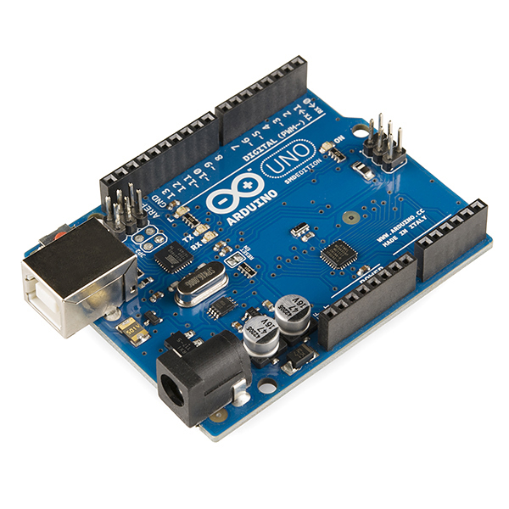
ARDUINO
Arduino is an open-source electronics platform based on easy-to-use hardware and software. Arduino boards are able to read inputs - light on a sensor, a finger on a button, or a Twitter message - and turn it into an output - activating a motor, turning on an LED, publishing something online. You can tell your board what to do by sending a set of instructions to the microcontroller on the board. To do so you use the Arduino programming language (based on Wiring), and the Arduino Software (IDE), based on Processing.

Slide 11

DESIGN OF PCB:-

Slide 12
PROCESS FLOW
MESSAGE SENT TO 108 SERVER
ACCIDENT OCCUR
1
2
3
DATA SENT TO CONTROLROOM THROUGH CAMERAS

